Slide 1
LIFE INSURANCE CORPORATION OF INDIA
WELCOMES YOU
TO THE PROFESSION OF LIC AGENCY
CONTACT US : +91 9845474003
joinlicbangalore@gmail.com

Slide 2
LIFE INSURANCE CORPORATION OF INDIA
Life Insurance Agency is considered as the highest paid Profession in the World.
Can earn unlimited income.
Even sky is not the limit.
CONTACT US : +91 9845474003
joinlicbangalore@gmail.com

Slide 3
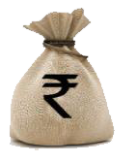
ADVANTAGES OVER OTHER PROFESSIONS
Start Business of your own without Capital Investment.
It also provides you with the Royalty Income.
Freedom to set your own working hours.
Your work gets easier and less demanding as the business grows
No Compulsory retirement.
Noble profession opens doors for social service
Within a short span of time Standard of living could be improved.
A tool in Nation building activities as money mobilized is used for people’s welfare.
CONTACT US : +91 9845474003
joinlicbangalore@gmail.com

Slide 4
BENEFITS TO YOU
As a LIC Agent you are entitled to
Commissions
Competition gift items.
Loans & Advances like Computer Advance, Housing loan, Marriage advance, Furniture advance, Festival advance, Interest free two wheeler & four wheeler advances
Group Term Insurance
Gratuity
Fringe benefits to Club member agent like free stationery, visiting card, envelope, office allowance etc.
CONTACT US : +91 9845474003
joinlicbangalore@gmail.com

Slide 5
MARKET POTENTIAL
STRONG LIC BRAND
You will be associated with one of the leading Life Insurance Company of the World
The brand image of LIC of India is so huge, that is why LIC is voted as the most trusted brand in India.
Thus selling of Life Insurance policies of LIC is much easier.
Only 20% of the insurable population is insured, while still there is potential of 80% of population that can be insured.
Life Insurance market is an ever growing business.
CONTACT US : +91 9845474003
joinlicbangalore@gmail.com

Slide 6
YOU EARN YOUR OWN PENSION
As years pass, the Renewal Commission starts building up thereby assuring you a pension for you and your generations to come.
TRUE SPIRIT OF SERVING THE PEOPLE AND NATION
CONTACT US : +91 9845474003
joinlicbangalore@gmail.com

Slide 7
CLUB MEMBERSHIP
Club membership is the recognition given for outstanding performance.
Corporate Club
Your path to the TOP
Chairman’s club
Zonal Manager’s Club
Divisional Manager’s club
Branch Manager’s club
Distinguished club
TRUE SPIRIT OF SERVING THE PEOPLE AND NATION
CONTACT US : +91 9845474003
joinlicbangalore@gmail.com

Slide 8
AN AGENT WILL GET INTERNATIONAL RECOGNITION BY QUALIFYING FOR
MDRT ( Million Dollar Round Table)
COT (Court of the Table)
TOP ( Top of the Table)
QUALIFLYING CONDITIONS | MDRT | COT | TOP
First year Commission | Rs. 8,45,300 | 25,35,900 | 50,71,800
First Year Premium. | Rs. 33,81,200 | 1,01,43,600 | 2,02,87,200
TRUE SPIRIT OF SERVING THE PEOPLE AND NATION
CONTACT US : +91 9845474003
joinlicbangalore@gmail.com

Slide 9
QUALITIES YOU NEED TO POSSESS
Strong determination & Self confidence
Ambitious to start your own business
Good communication skills
Willingness to share
Thirst for Knowledge
Quest for Self-Improvement
Eagerness to build relationships
Smart working
Positive attitude, Consistency & Perseverance
CONTACT US : +91 9845474003
joinlicbangalore@gmail.com

Slide 10
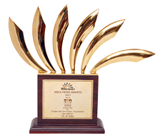
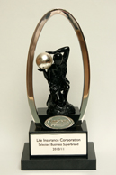
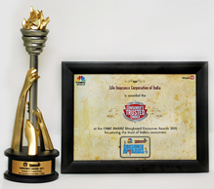
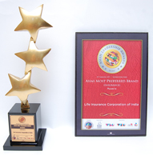
BE PROUD TO BE ASSOCIATED WITH THE ONLY
INSURANCE COMPANY WITH MAXIMUM AWARDS
CONTACT US : +91 9845474003
joinlicbangalore@gmail.com

Slide 11
LIFE INSURANCE CORPORATION OF INDIA
CONTACT US : +91 9845474003
joinlicbangalore@gmail.com

